Slide 1
Plagiarism Detector
Team 214
Members
Aditya Batheja
Tanvi Ranadive
Deepak Surana
Mihir Gandhi

Slide 2
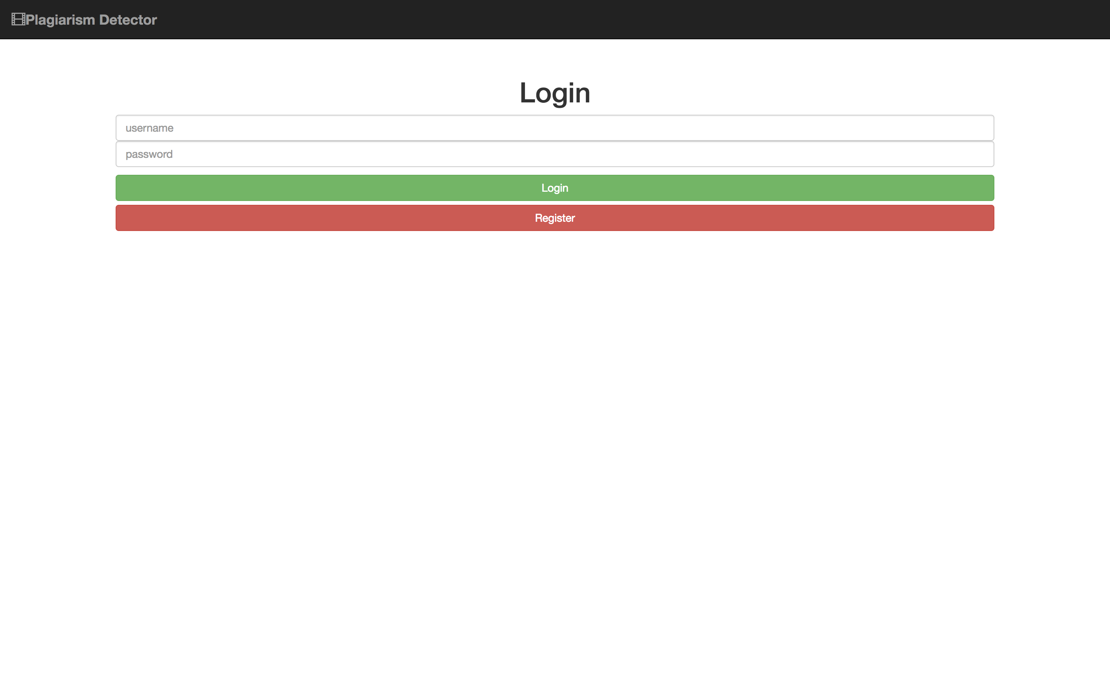
Plagiarism Detector

Slide 3
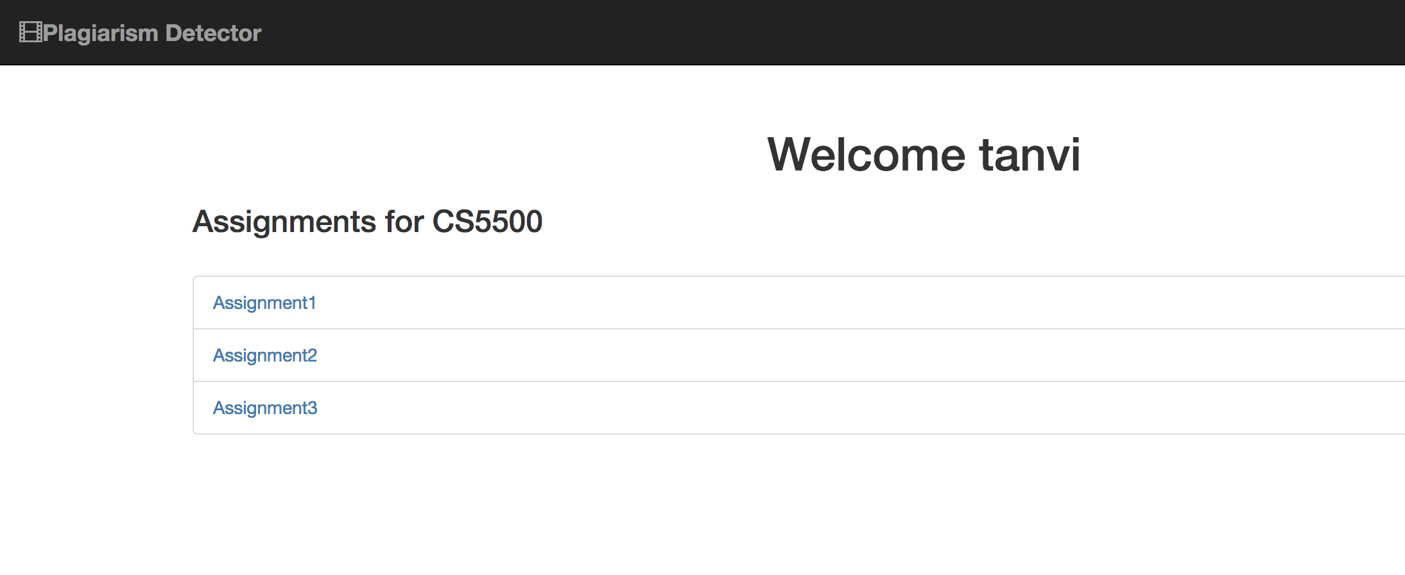
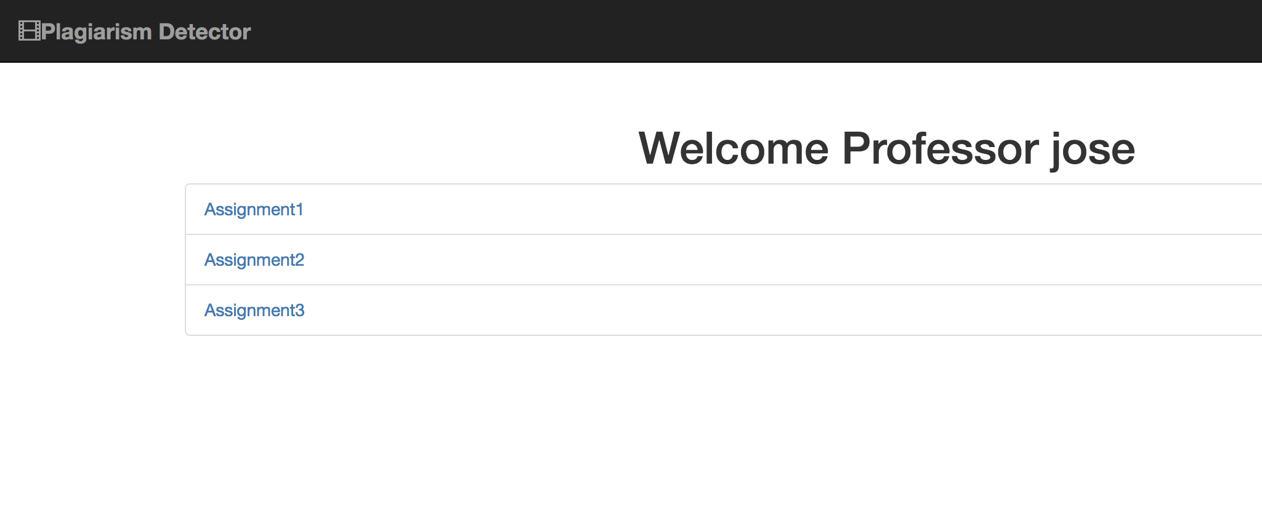
Application Functionality
Two roles for a user in the application: Student or Professor

Slide 4
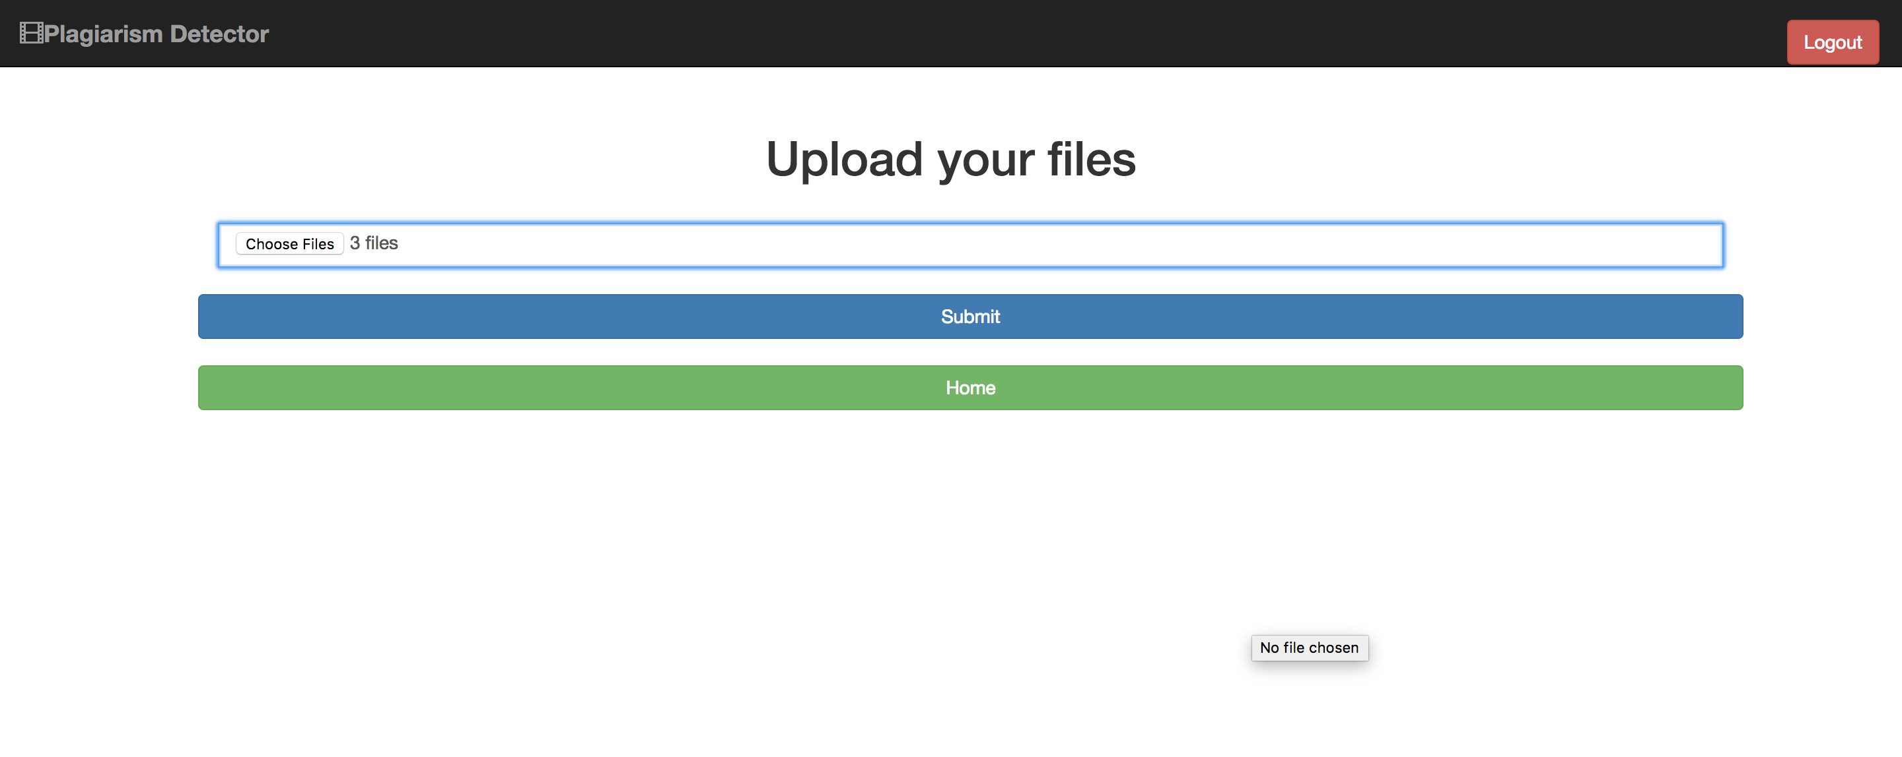
Student Upload

Slide 5
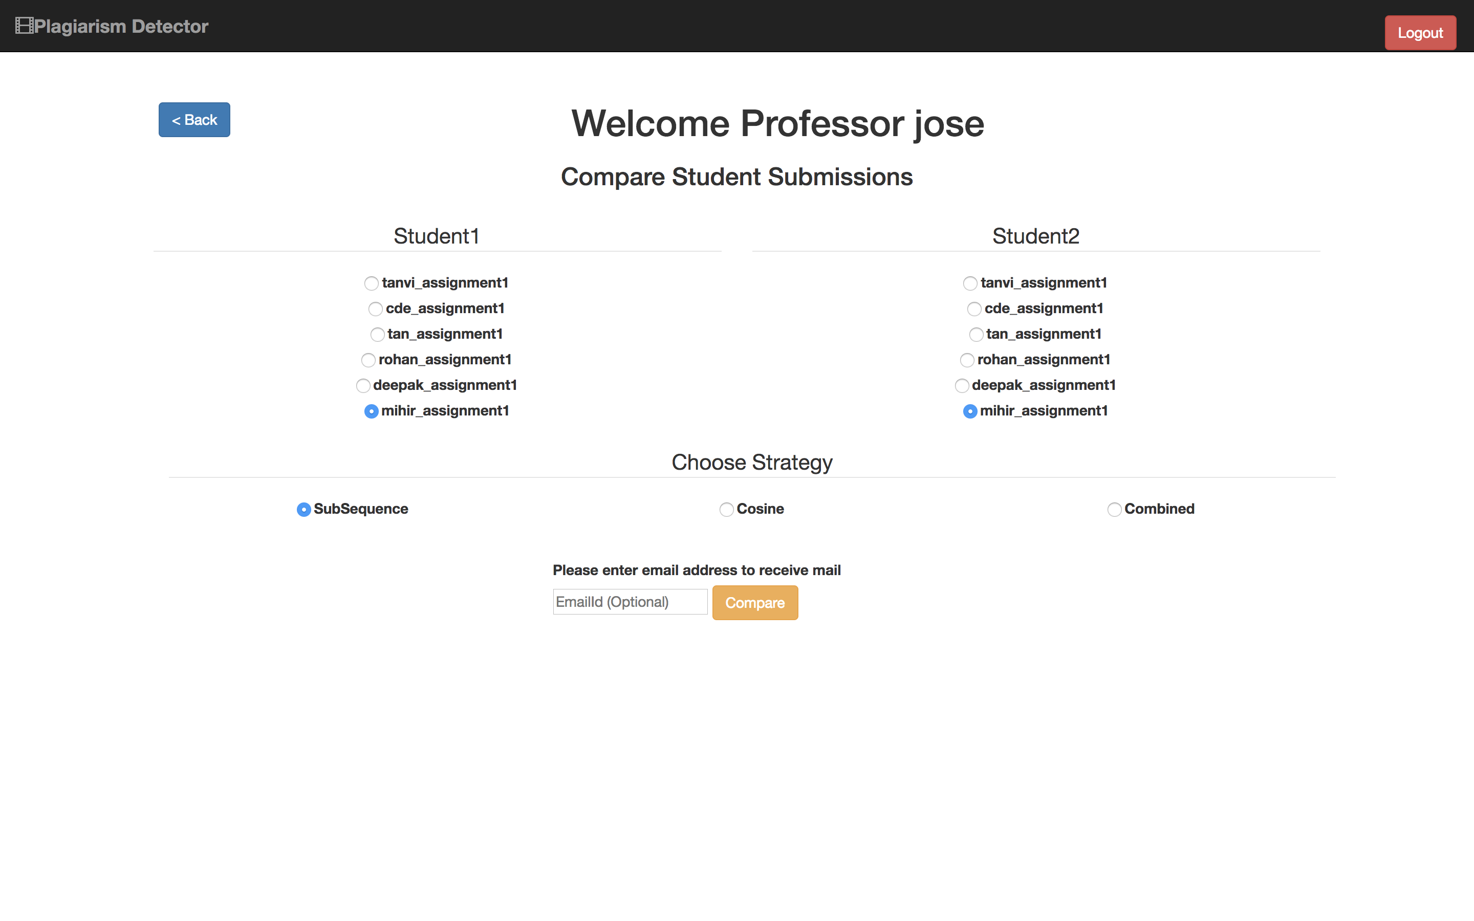
Professor Check Plagiarism
Professor chooses two students to be compared
A strategy can be chosen for comparison

Slide 6
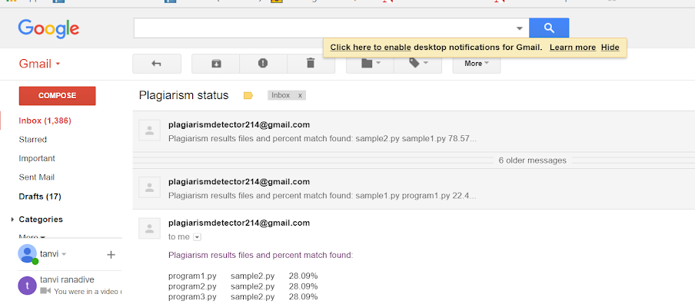
Email

Slide 7
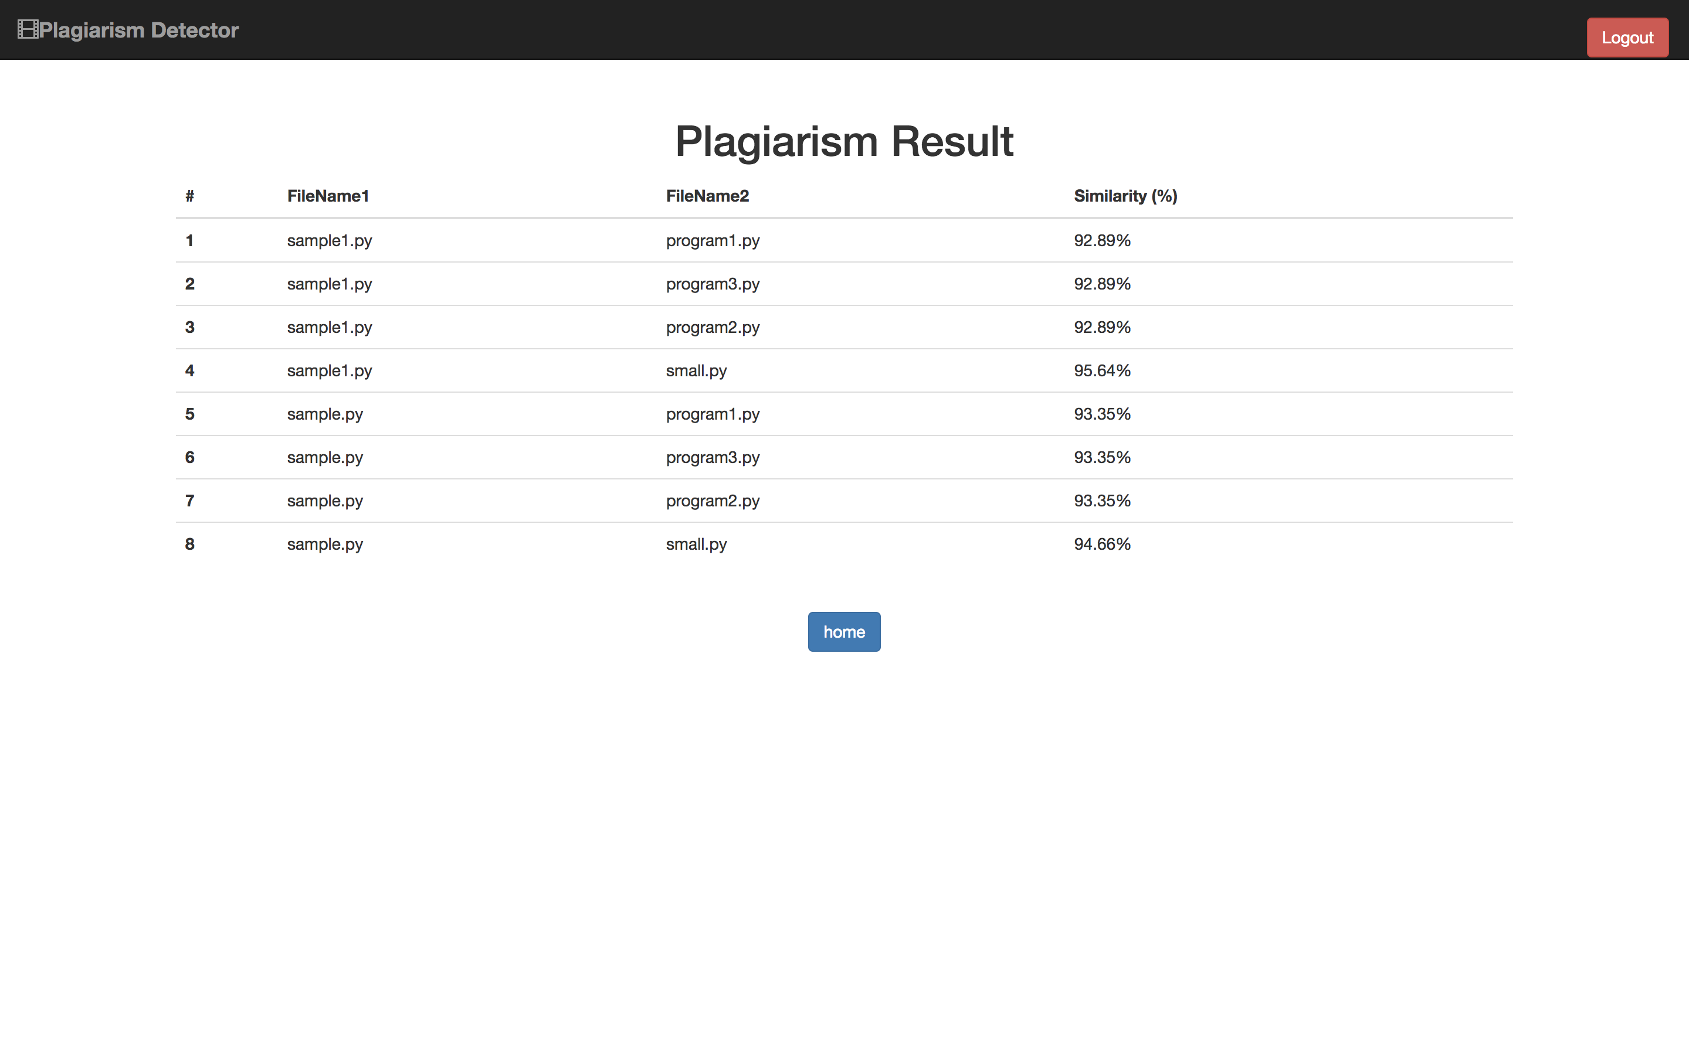
Results

Slide 8
Project Functionality Recap
Basic Functionalities :
Performs plagiarism check for python files.
Uses more than 1 comparison strategies.
Stretches :
Performs plagiarism check for multiple python files.
Performs plagiarism check for multiple submissions.
Uses more than 1 comparison strategies and a weighted polynomial function.
Email functionality.

Slide 9
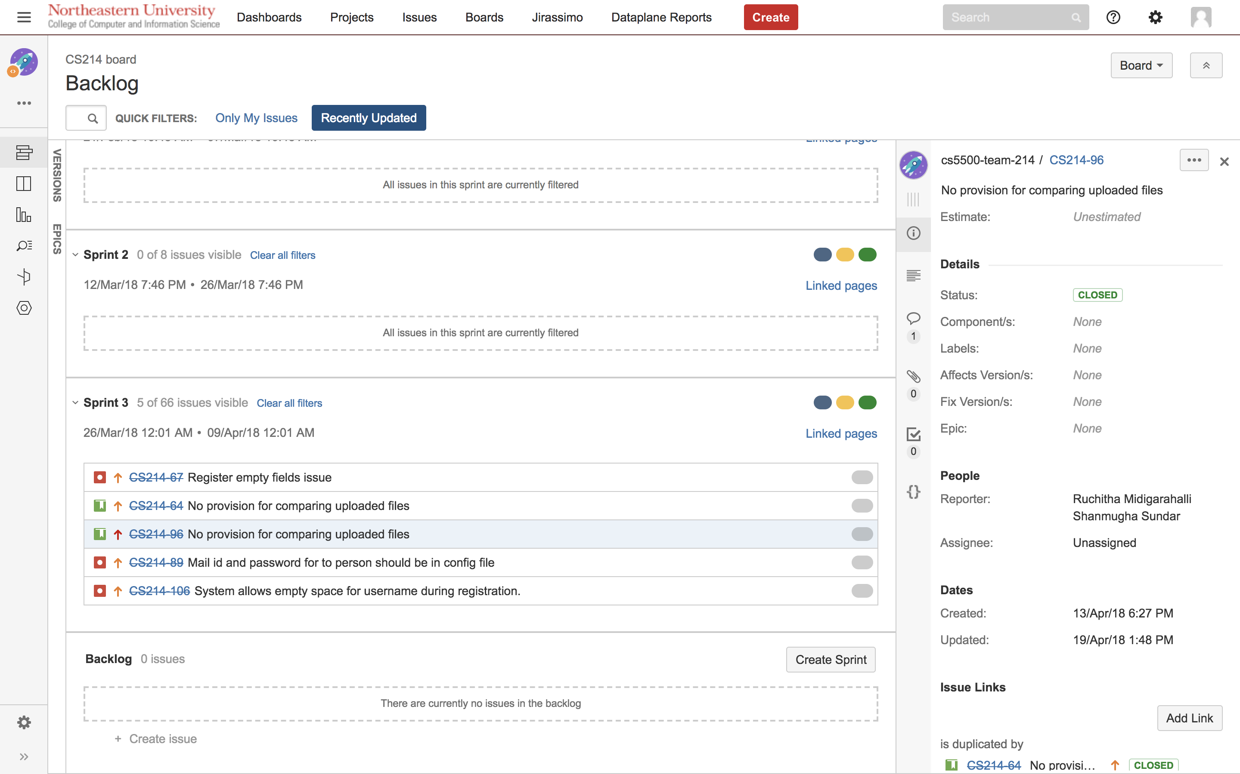
Jira Backlog

Slide 10
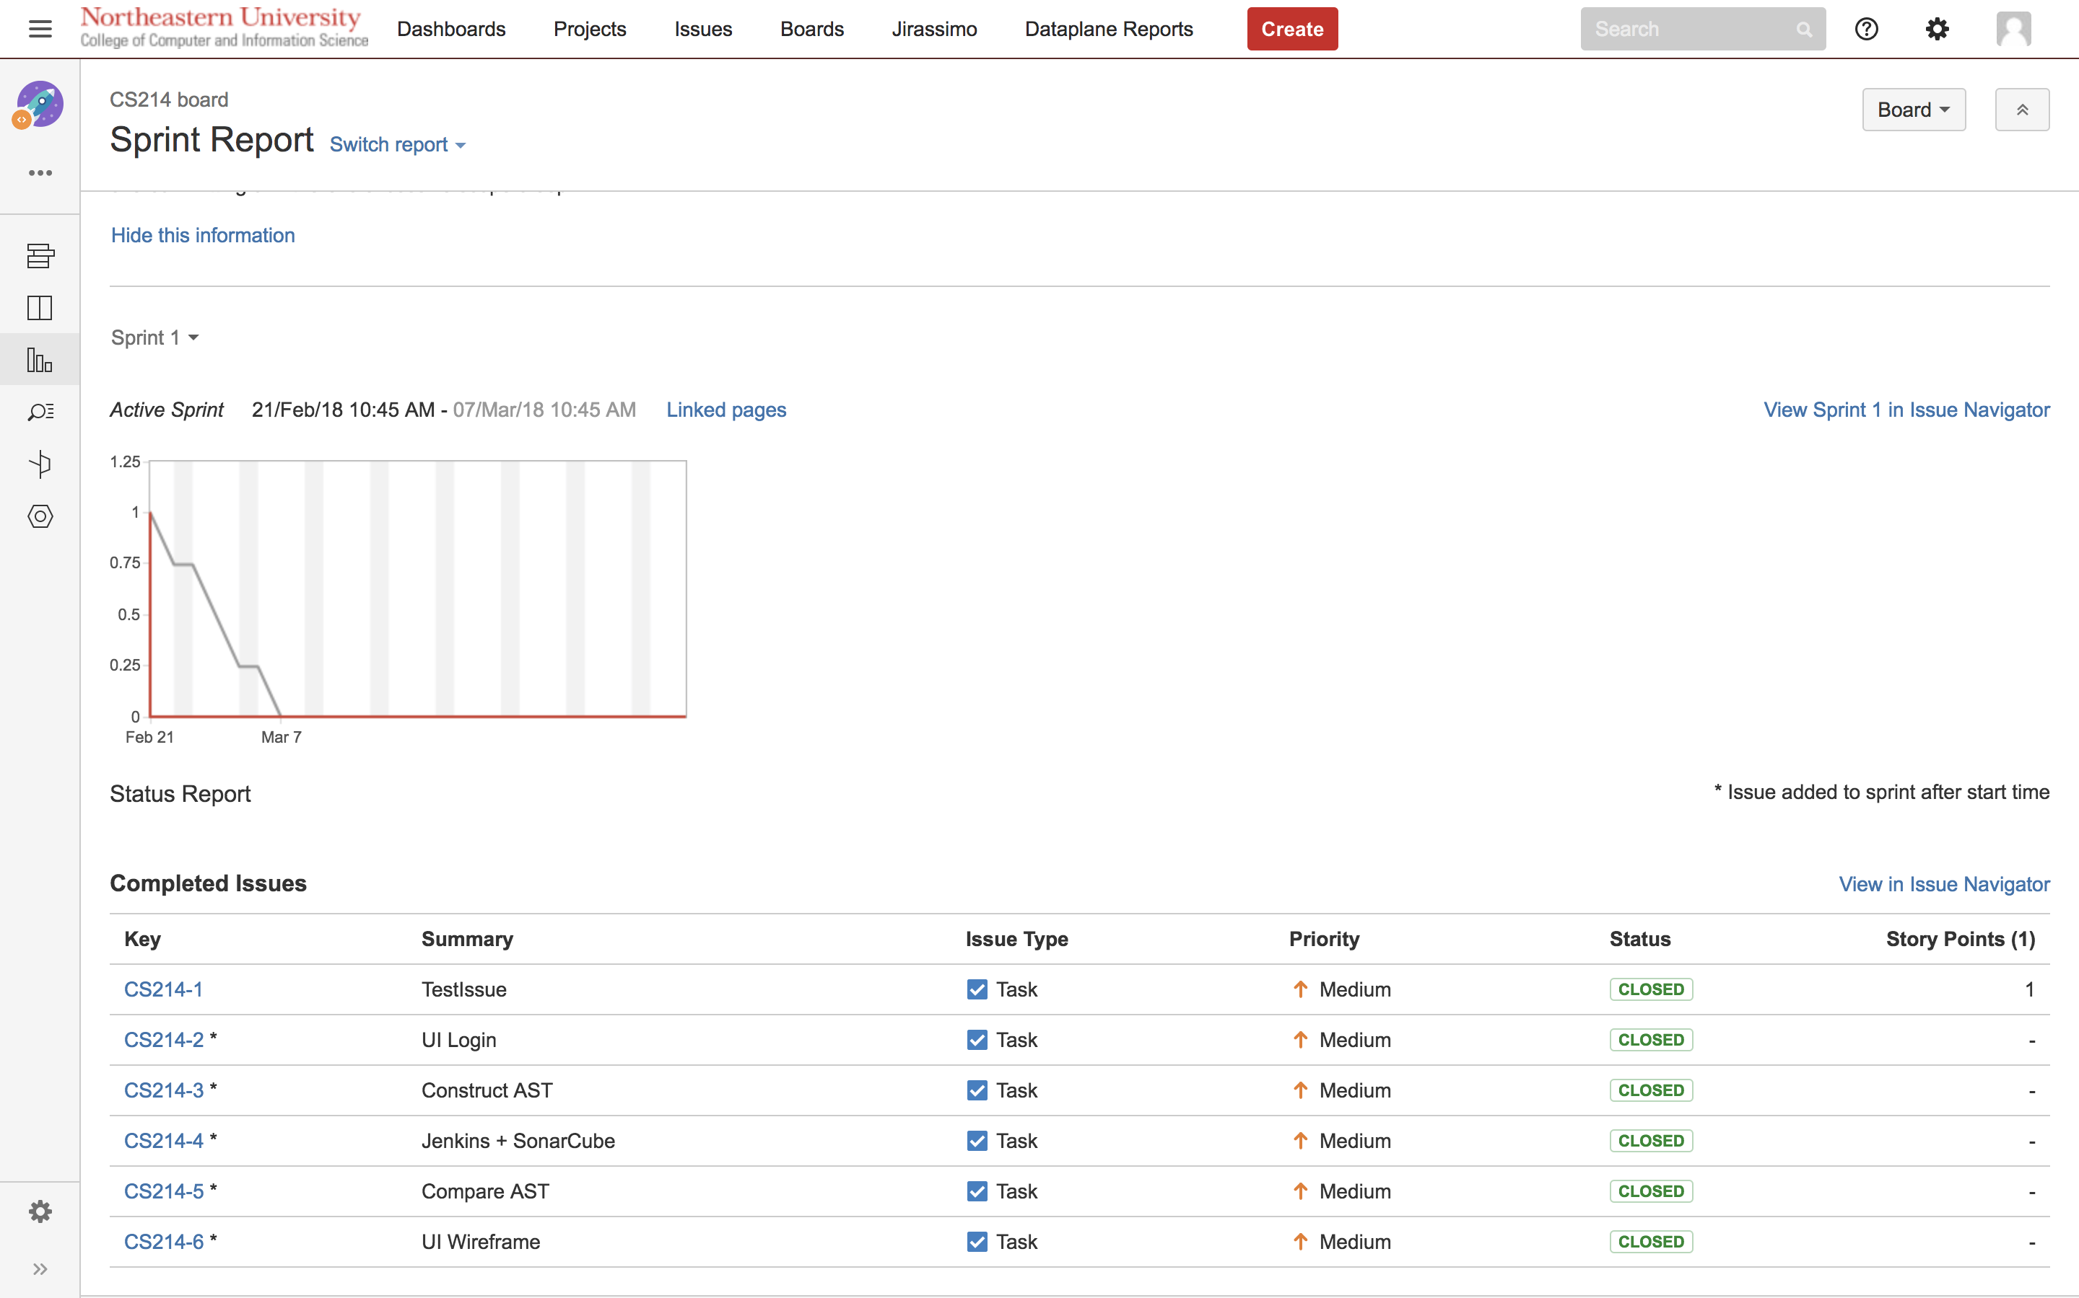
JIRA Reports Sprint 1

Slide 11
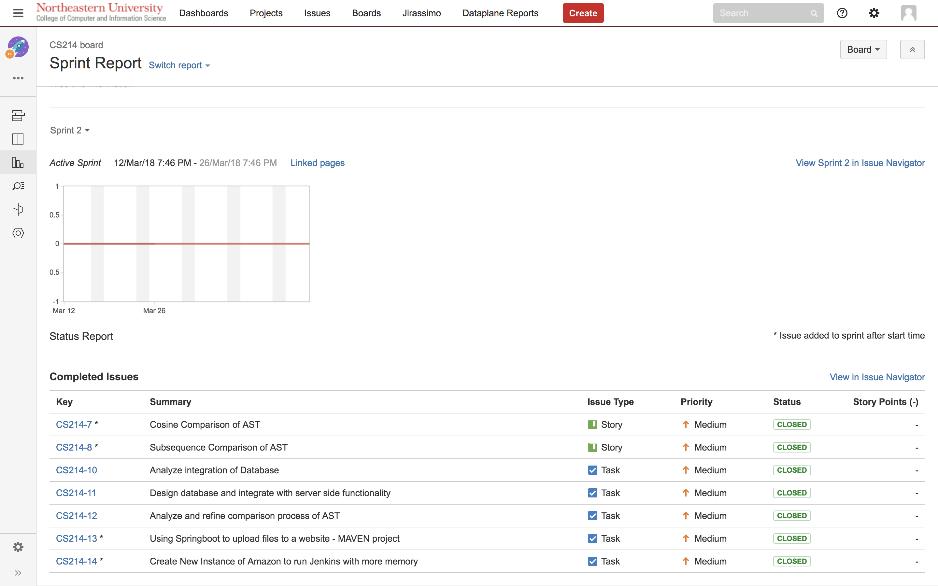
JIRA Reports Sprint 2

Slide 12
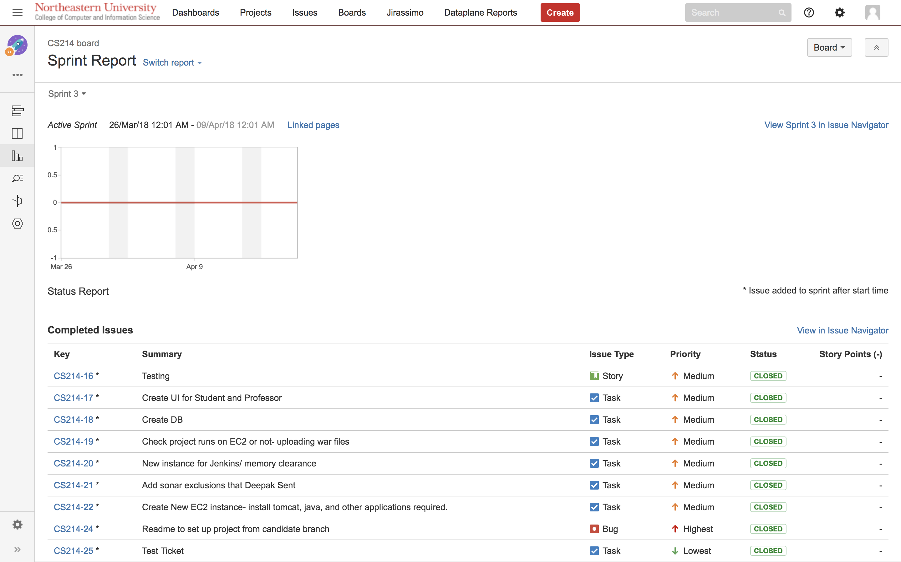
JIRA Reports Sprint 3

Slide 13
Job Quality
Github Checks
Jenkins CI
SonarQube

Slide 14
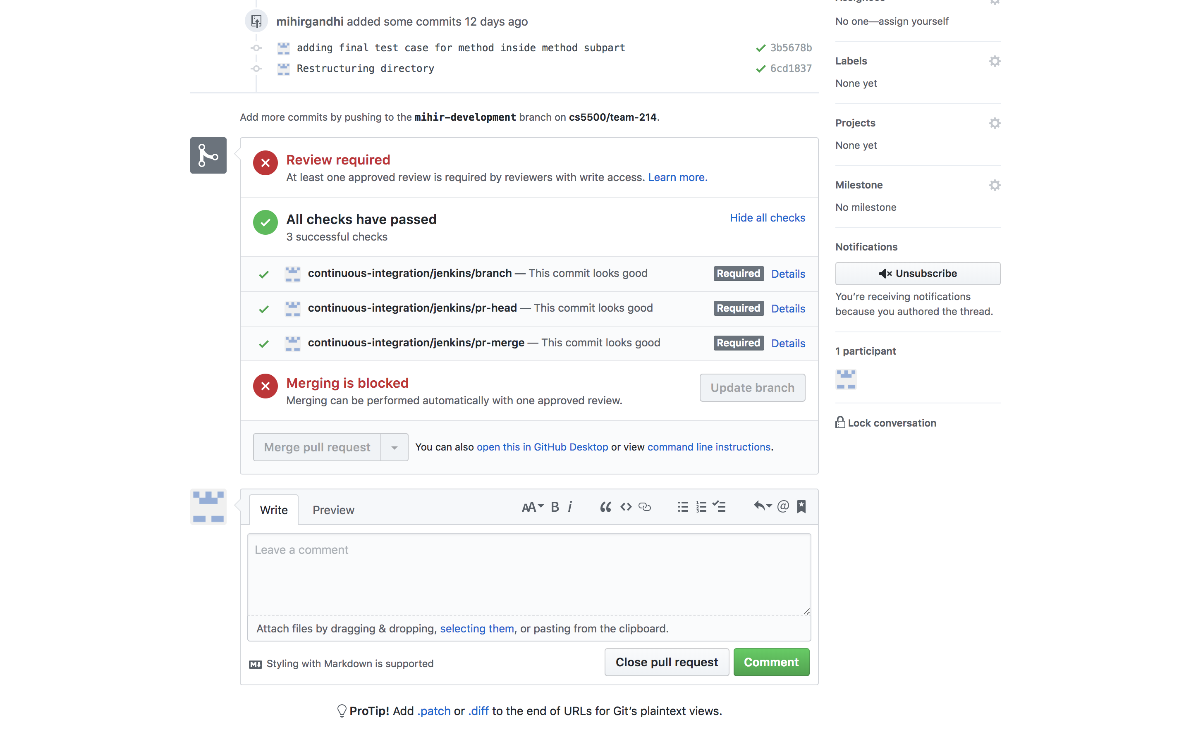
GitHub Status Checks

Slide 15
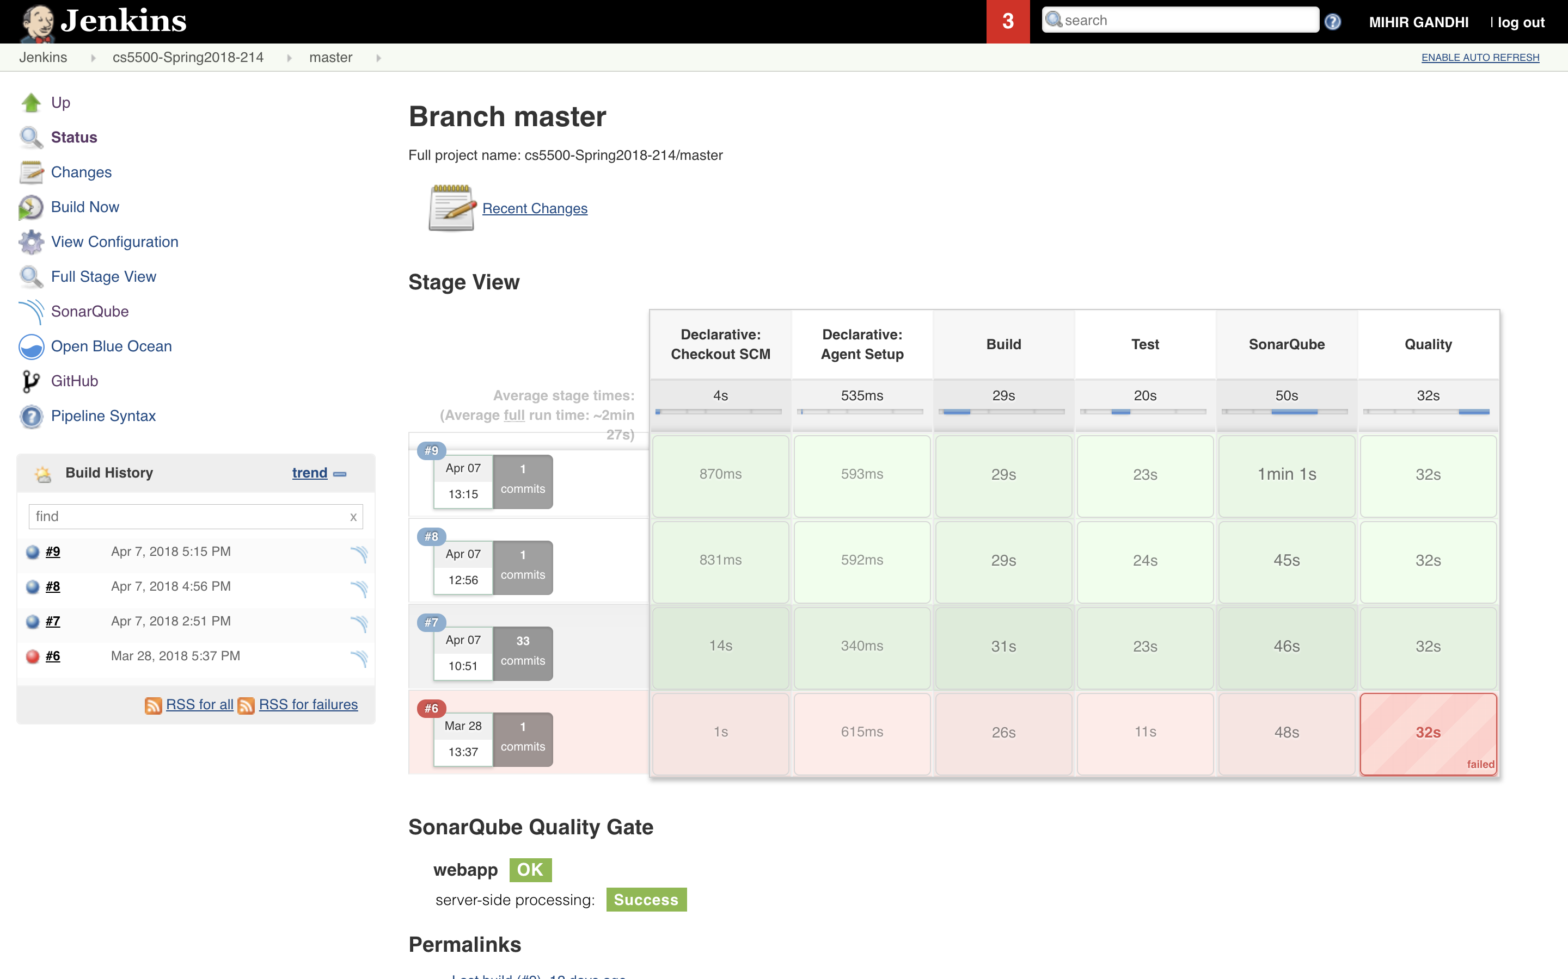
Jenkins CI

Slide 16
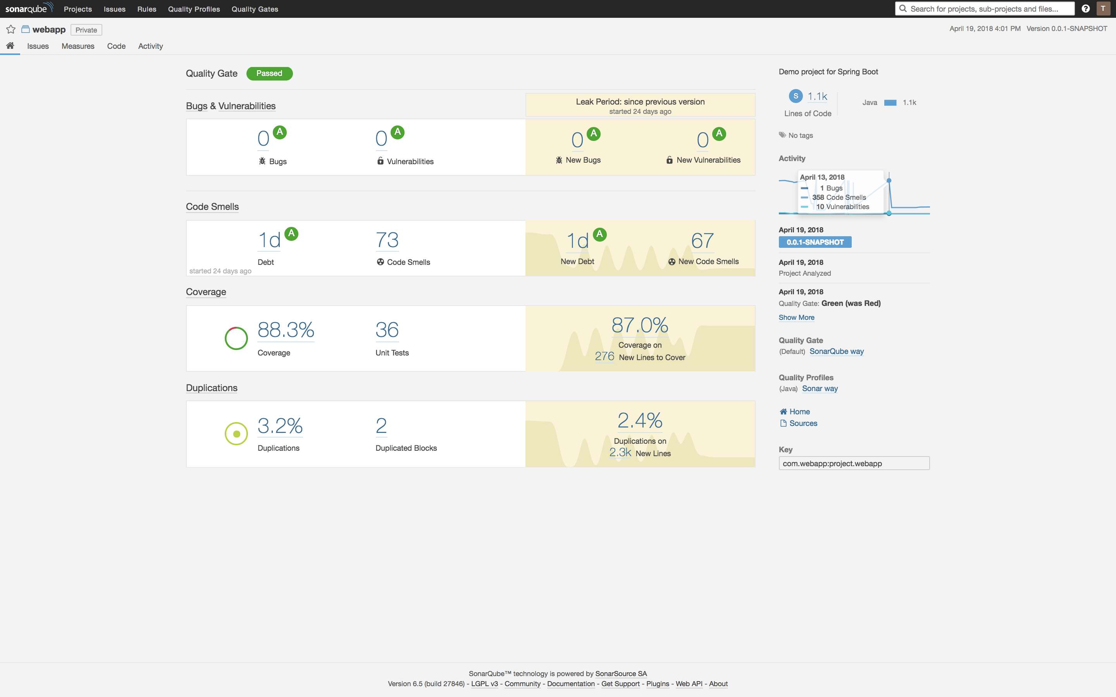
SonarQube Report

Slide 17
The perfect is the enemy of the good- Voltaire
Good Enough became our goal for the project.
Our team decided to use Agile Methodology to implement the sprints.
The lifecycle of the sprints was 2 weeks
We updated our team members on our daily goals through slack
JIRA was used for issue tracking

Slide 18
Problems Faced during the project
How many options to consider, before stopping
Keep exploring or start exploiting
Deciding the order for tasks that needed to be completed
Which steps need to be performed every time and how to automate them
When to invert priority of tasks
When to practice constraint relaxation
Cobham–Edmonds thesis

Slide 19
Technologies used in the Project
GitHub for Version Control
JIRA for issue tracking
Jenkins for Continuous Intergration
SonarQube for Code Analysis
AWS for Deployment
Spring boot Application for Development

Slide 20
Future Scope
Display parts of files that have plagiarism
Support for other languages
Provide functionality for comparing files from previous semesters
Provide functionality for comparing different sections of the same course
Perform A/B testing for users

Slide 21
Thank you

